Slide 1



Atliq Hardwares Sales Insights

Slide 2
List of markets in which customer "Atliq Exclusive" operates
in the APAC region
1. Question:
Provide the list of markets in which customer "Atliq Exclusive" operates its business in the APAC region.
Output:

Slide 3
percentage of unique product increase in 2021 vs. 2020
2. Question:
What is the percentage of unique product increase in 2021 vs. 2020? The final output contains these fields,
unique_products_2020
unique_products_2021
percentage_chg
Output:
Insights
The unique product increase from fascial year 2020 to 2021 is 73.4 percent more.

Slide 4
Unique product counts for each segment
3. Question:
Provide a report with all the unique product counts for each segment and sort them in descending order of product counts. The final output contains 2 fields,
segment
product_count
Output:

Slide 5
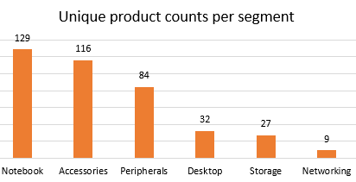
Conversion Of Output To Visual
Insights
Notebook, Accessories and Peripherals are the top 3 segment as per the unique product count.
Strategy to be devised for the Bottom 3 segments to increase the sales.

Slide 6
Unique product counts for each segment
4. Question:
Follow-up: Which segment had the most increase in unique products in 2021 vs 2020?
The final output contains these fields,
segment
product_count_2020
product_count_2021
difference
Output:

Slide 7
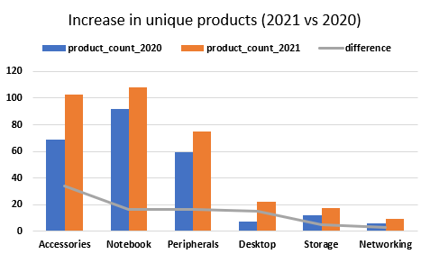
Conversion Of Output To Visual
Insights
Accessories had the major increase followed by Notebook, Peripherals and Desktop compared to
Storage and Networking.
2. This insight shows the positive tends for overall segment of product.
3. Needs to figure out to increase the count of storage and Networking.

Slide 8
Products having highest and lowest manufacturing costs
5. Question:
Get the products that have the highest and lowest manufacturing costs. The final output should contain these fields,
product_code
product
manufacturing_cost
Output:
Fiscal Year 2020 Highest manufacturing cost
Fiscal Year 2021 Highest manufacturing cost
Fiscal Year 2020 Lowest manufacturing cost
Fiscal Year 2021 Lowest manufacturing cost

Slide 9
Output
Fiscal Year 2020 Highest manufacturing cost
Fiscal Year 2021 Highest manufacturing cost
Fiscal Year 2020 Lowest manufacturing cost
Fiscal Year 2021 Lowest manufacturing cost
Insights
In fiscal year 2020, products “AQ Home Allin1” and “AQ Master wired x1 Ms” had highest and lowest manufacturing costs respectively.
In fiscal year 2021, product “AQ Home Allin1 Gen 2” had highest manufacturing cost and two products “AQ Master wired x1 Ms” & “AQ Pen Drive DRC” had lowest manufacturing costs.
But the manufacturing cost of product “AQ Master wired x1 Ms” was increased from 0.892 in 2020 to 0.9195 in 2021.

Slide 10
Top 5 customers with an average high pre_invoice_discount_pct
6. Question:
Generate a report which contains the top 5 customers who received an average high pre_invoice_discount_pct for the fiscal year 2021 and in the Indian market. The final output contains these fields,
customer_code
customer
average_discount_percentage
Output:

Slide 11
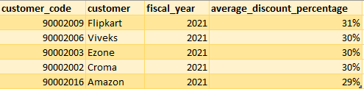
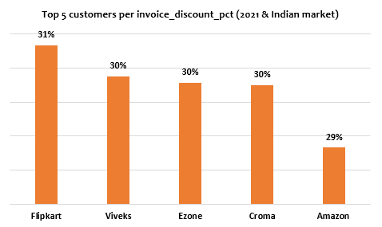
Conversion Of Output To Visual
Insights
The top 5 customers who got an average high pre_invoice_discount_pct for the fiscal year 2021 and in the Indian market are Flipkart with 31%, viveks, Ezone & Croma with 30% and Amazon with 29% discounts.
All the top 5 customer have received almost same discounts.
These customers are the ones who have sold more number of goods for Atliq hardwares then others as per the discount availed.

Slide 12
Gross sales amount for the customer “Atliq Exclusive”
7. Question:
Get the complete report of the Gross sales amount for the customer “Atliq Exclusive” for each month. This analysis helps to get an idea of low and high-performing months and take strategic decisions. The final report contains these columns:
Month
Year
Gross sales Amount
Output:

Slide 13
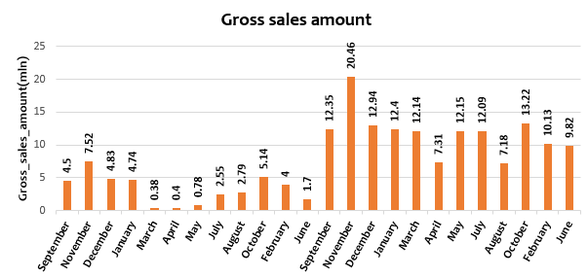
Conversion Of Output To Visual
Insights
The gross sales amount for Atliq Exclusive show as growth from 2021 as compared to 2020.
March, April & May of 2020 was the lean period for Atliq Exclusive .
2021 was the very good year as the gross sales amount was more than doubled as compared to 2020.
November 2021 wass the top month as the gross sales was 20.46 mln.
Overall the gross sales look on positive trend.

Slide 14
Quaterly maximum total_sold_quantity
8. Question:
In which quarter of 2020, got the maximum total_sold_quantity? The final output contains these fields sorted by the total_sold_quantity,
Quarter
total_sold_quantity
Output:

Slide 15
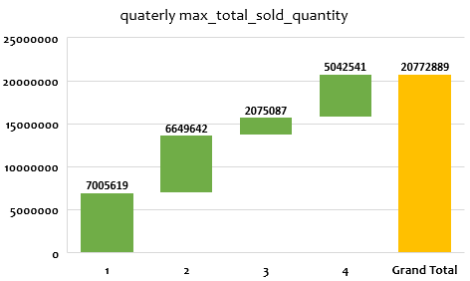
Conversion Of Output To Visual
Insights
In fiscal year 2020, quarter 1 has maximum sold quantity followed by quarter 2 and 4.
Quarter 3 has the least sold quantity.

Slide 16
Gross sales channel wise
9. Question:
Which channel helped to bring more gross sales in the fiscal year 2021 and the percentage of contribution? The final output contains these fields,
channel
gross_sales_mln
percentage
Output:
Insights
Retailer channel has brought more gross sales 1219.08 mln in fiscal year 2021 .
It has contributed 73.23% of overall gross sales.

Slide 17
Top 3 products by division
10. Question:
Get the Top 3 products in each division that have a high total_sold_quantity in the fiscal_year 2021? The final output contains these fields,
division
product_code
product
total_sold_quantity
rank_order
Output:

Slide 18
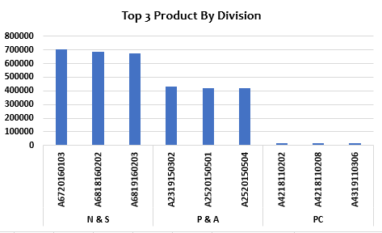
Conversion Of Output To Visual
Insights
Division “N & S” has highest sold quantity followed by “P & A” and “PC” .
Within division “N & S” product AQ Pen Drive 2 IN 1 has the highest sold quantity.
These are two product_code with same product names in “P & A” and “PC” divisions.
Need to devise a strategy to up the sold quantity of “P & A” and “PC” divisions.

